Slide 1
Reproducible Research: Writing an R Package
Prof James P Curley
jc3181@columbia.edu
@jalapic

Slide 2
Materials will be available here:
twitter.com/jalapic
GitHub.com/jalapic/RPackage

Slide 3


Slide 4
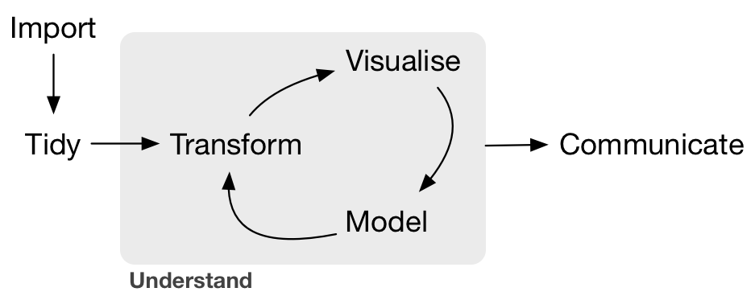
Research Workflow – ideally automated and reproducible
Wickham & Grolemund / RStudio

Slide 5
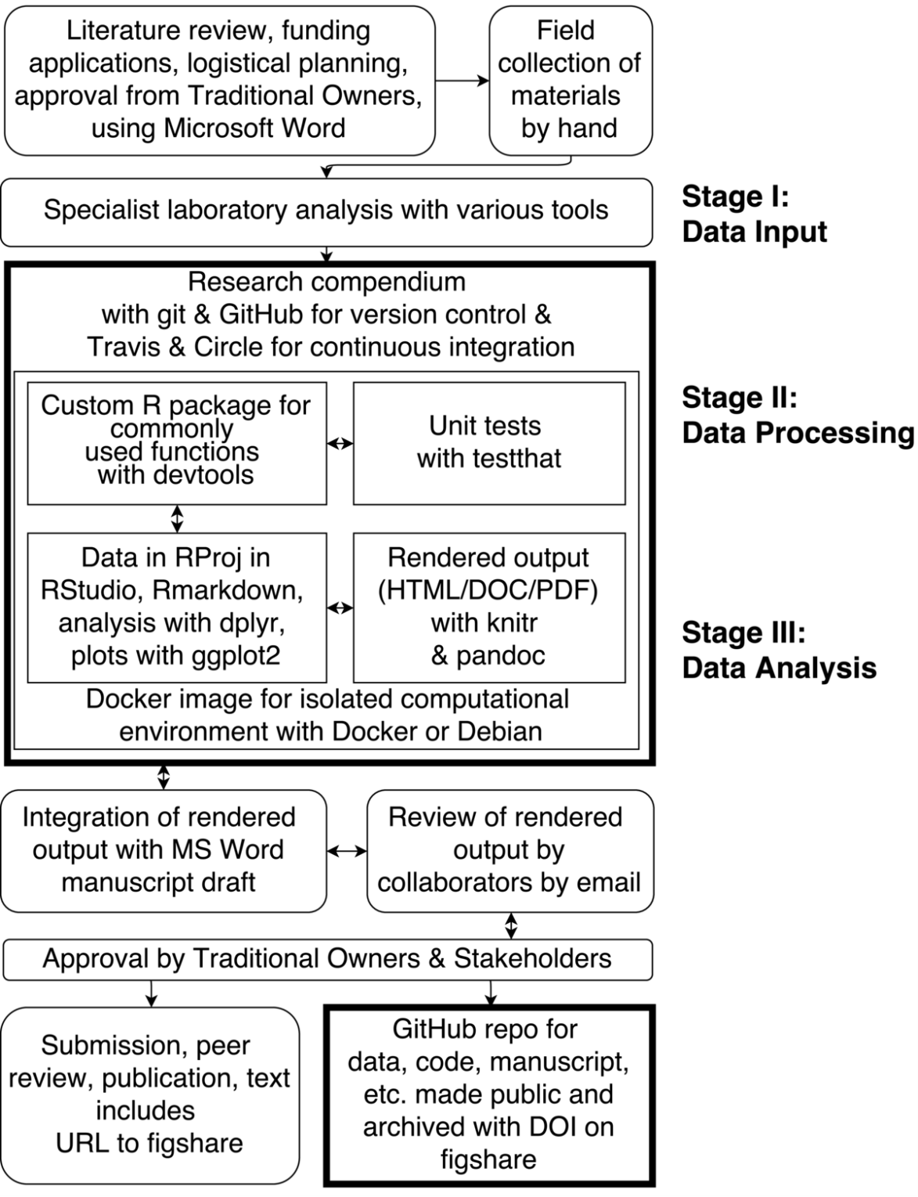
Using R & Rstudio for Reproducible Research
It can be overwhelming !
Let’s start with one method –
Writing an R package
https://www.practicereproducibleresearch.org/case-studies/benmarwick.html

Slide 6
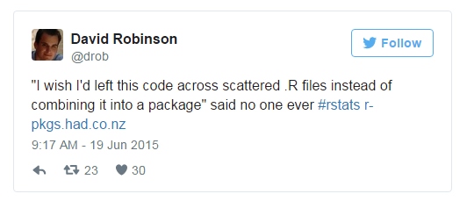
Inspiration for writing a R package
Organization: Keep all .R files and data related to a project in the same place
Documentation: Helpful documentation enables you to remember how to use functions you’ve written – as well as your colleagues
Collaboration: Others will be able to follow your work and reproduce it – they may even collaborate to help improve the work
Credit: Producing an R package is added productivity and can is evidence of contribution to research. Especially if the package is available on CRAN it shows that you have worked up to a high standard in making the package.

Slide 7
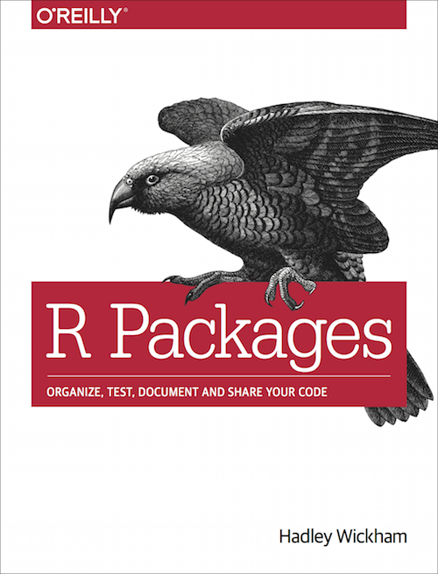
References
Very helpful tutorials/blogs:
https://www.analyticsvidhya.com/blog/2017/03/create-packages-r-cran-github/
http://web.mit.edu/insong/www/pdf/rpackage_instructions.pdf
https://hilaryparker.com/2014/04/29/writing-an-r-package-from-scratch/
http://kbroman.org/pkg_primer/
http://stat545.com/packages00_index.html
http://tinyheero.github.io/jekyll/update/2015/07/26/making-your-first-R-package.html
If you’re bold:
https://cran.r-project.org/doc/manuals/r-release/R-exts.html
The BEST resource
http://r-pkgs.had.co.nz/

Slide 8
Writing our first basic R package
We will use Rstudio to build our package utilizing two packages:
devtools
roxygen2

Slide 9
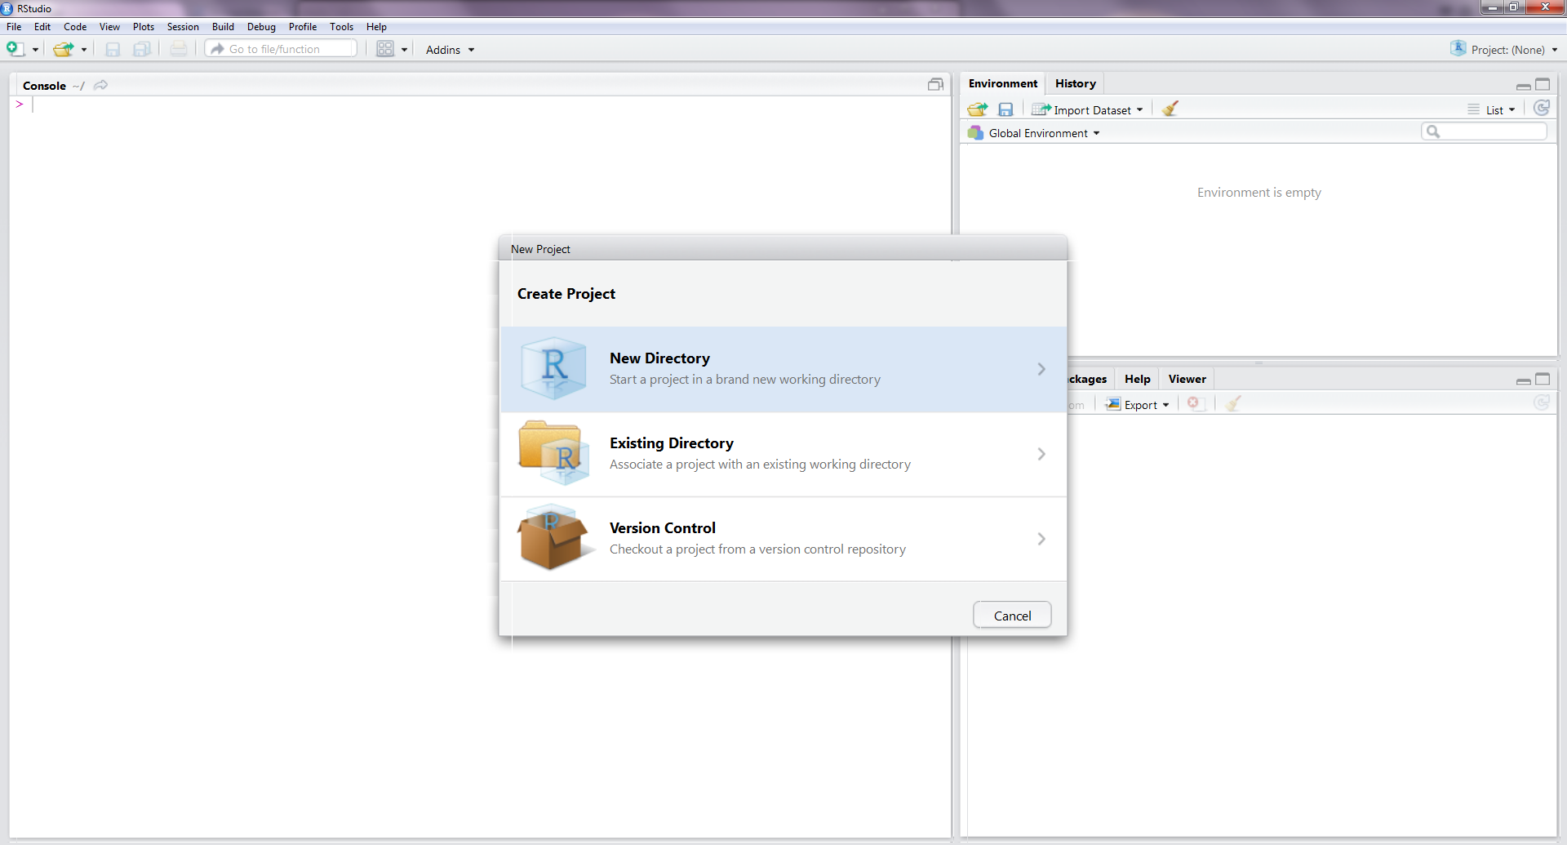
Project > New Project or File > New Project

Slide 10
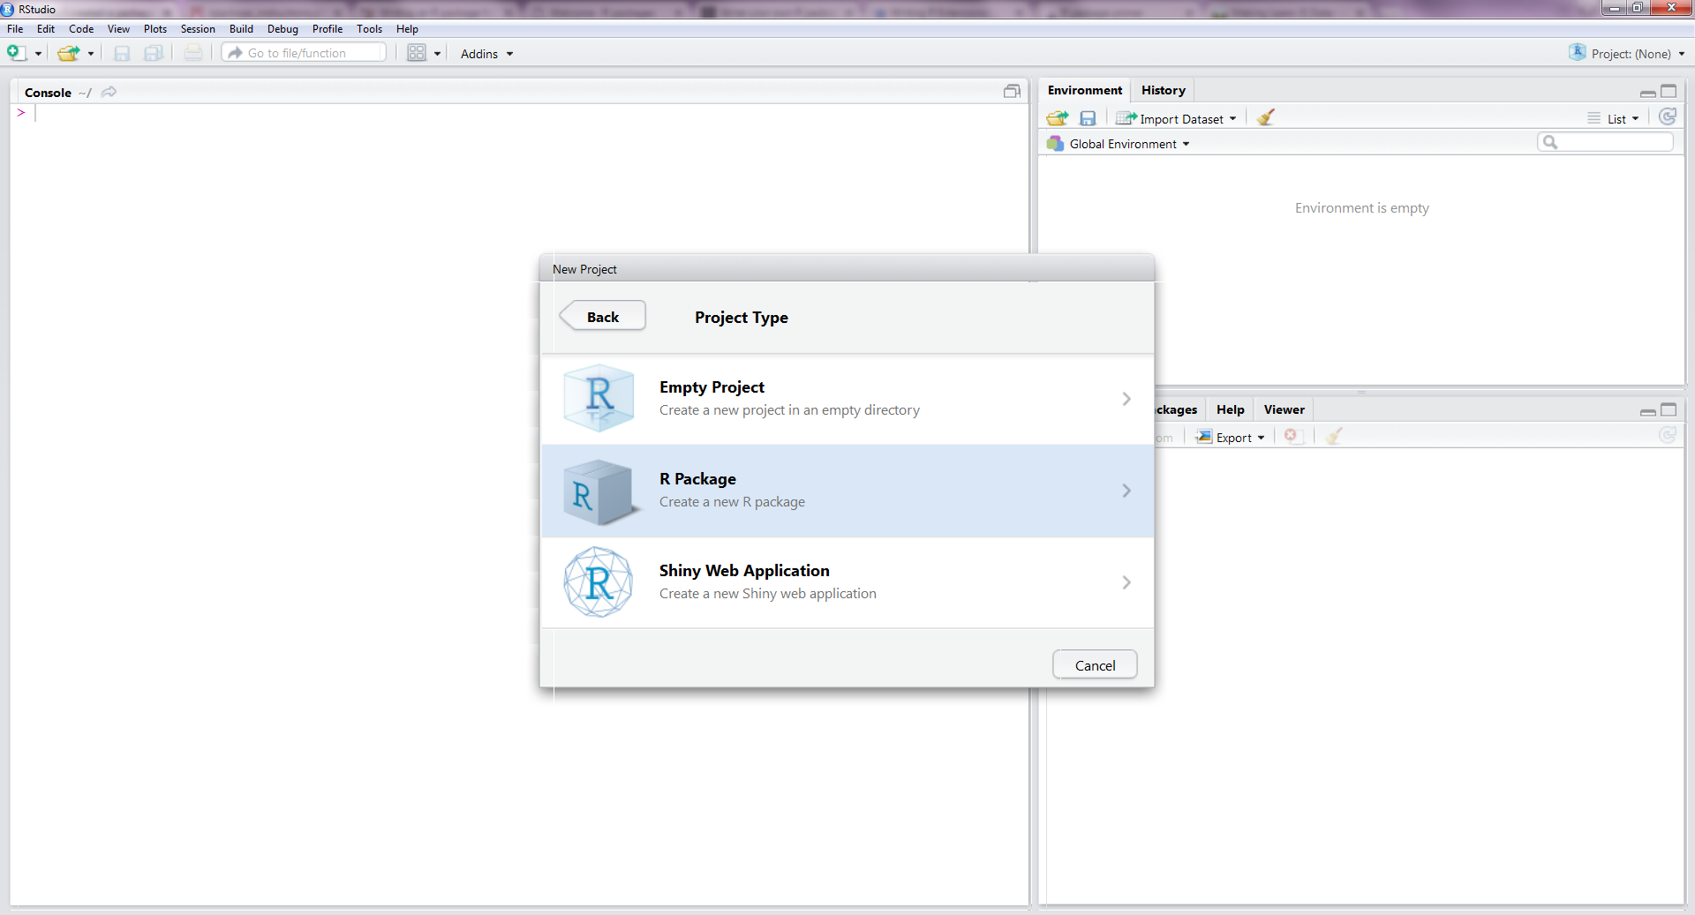
New Directory > R Package

Slide 11
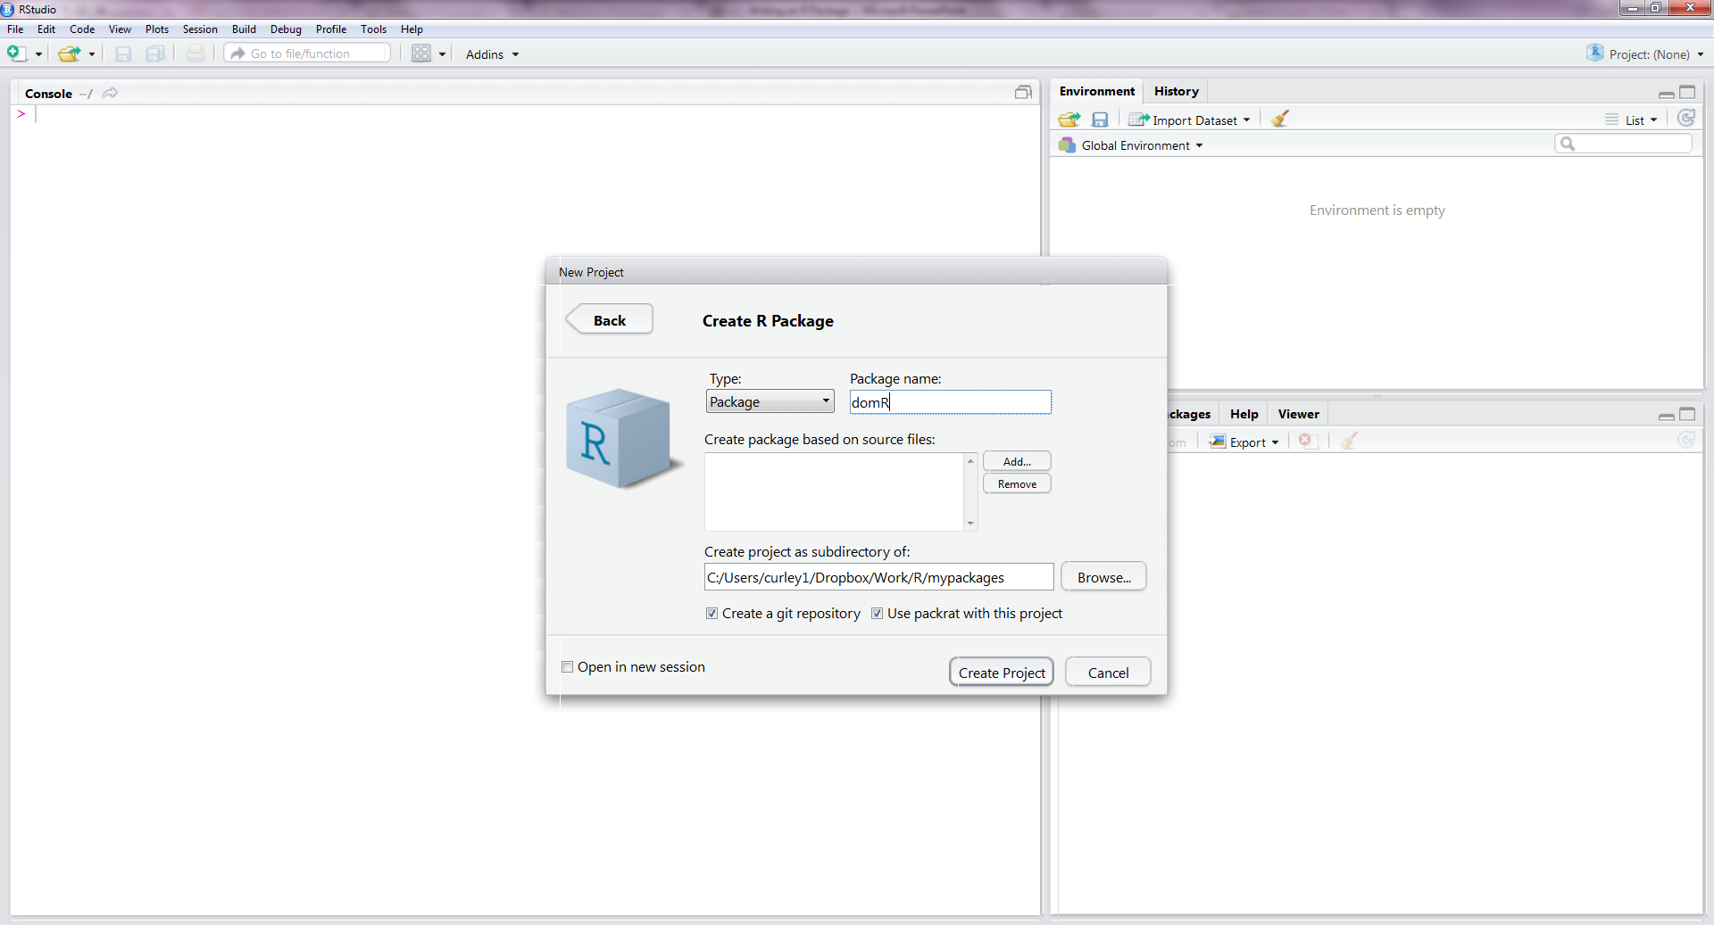
Choose a package name and a folder location
Why “packrat” ?

Slide 12
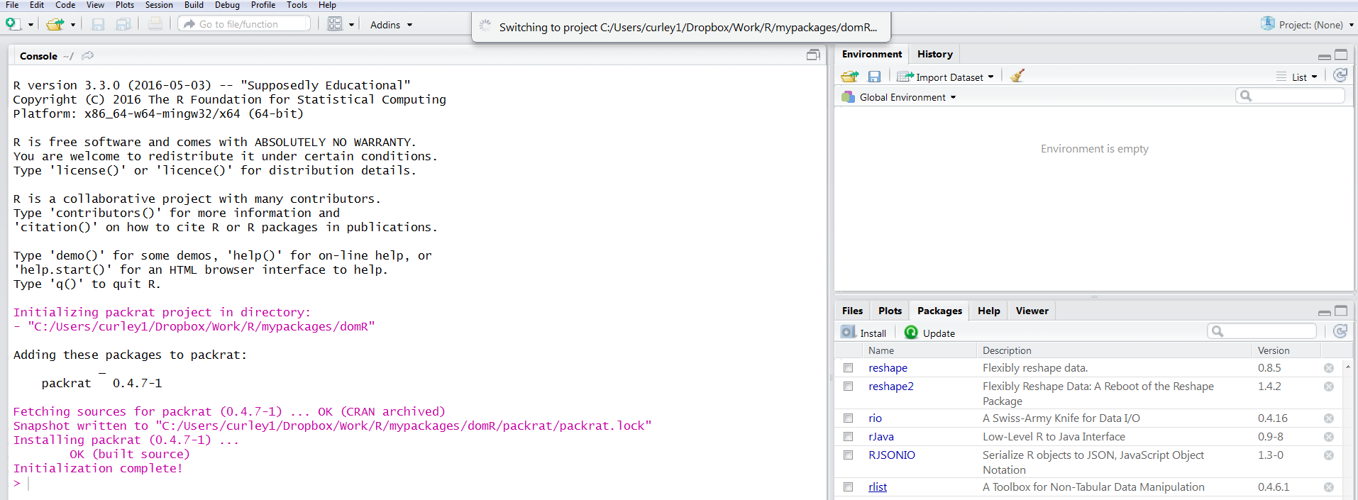
You should see this happen….

Slide 13
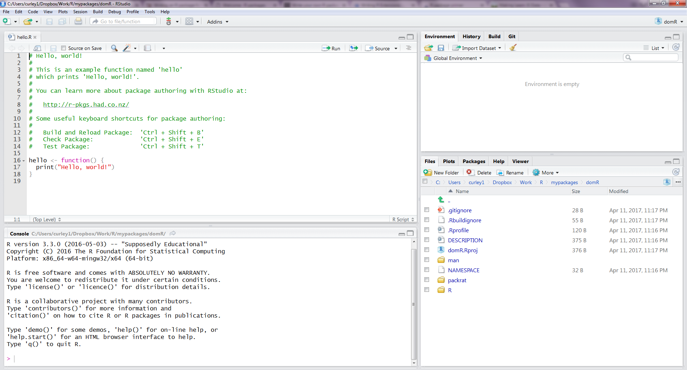
Several Files will be auto-generated in your folder like this: (I’ll explain what these are)

Slide 14
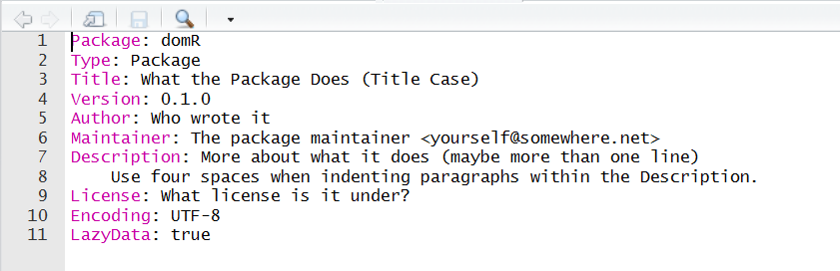
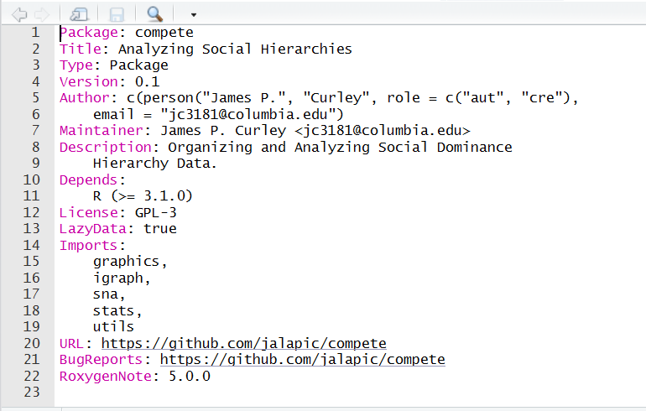
Populate the DESCRIPTION file:
http://r-pkgs.had.co.nz/description.html
From this
To something like this
If package uses functions from other packages, include them in the “Imports” section.
It’s better in most cases to put them in “Imports” rather than “Depends”

Slide 15
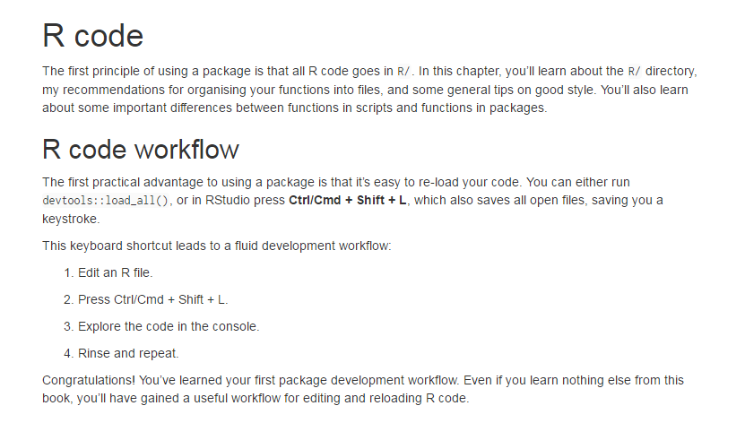
Add .R functions to R folder
See http://r-pkgs.had.co.nz/r.html for advice on code style and best practice

Slide 16
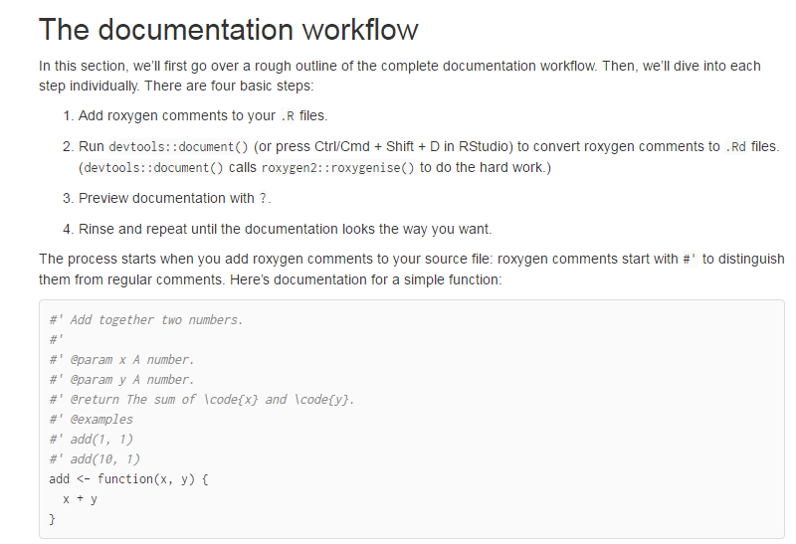
Add roxygen comments to top of .R functions script
See http://r-pkgs.had.co.nz/man.html for style guide and best practice

Slide 17
roxygen comments
title = title of the function.
description = detailed explanation of what the package does.
param = parameters/arguments in function. You can use multiple ‘param’ return = what object the function returns
importFrom = functions you need from other packages
examples = sample code (keep it small)
section = anything else relevant that you might want to add
export = function to export

Slide 18
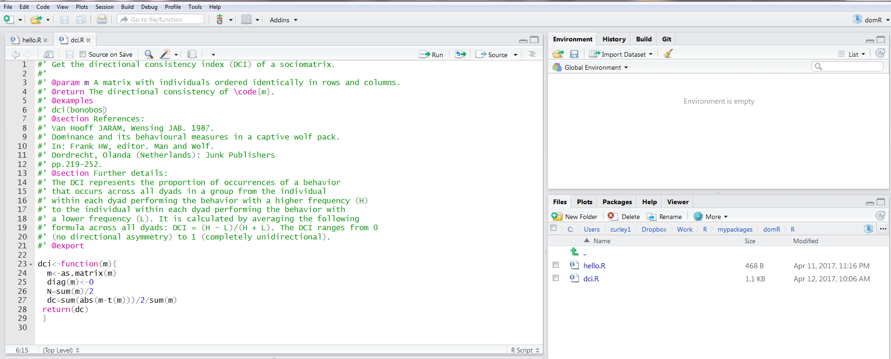
Add .R functions to R folder and add roxygen comments
Save functions with name of function

Slide 19
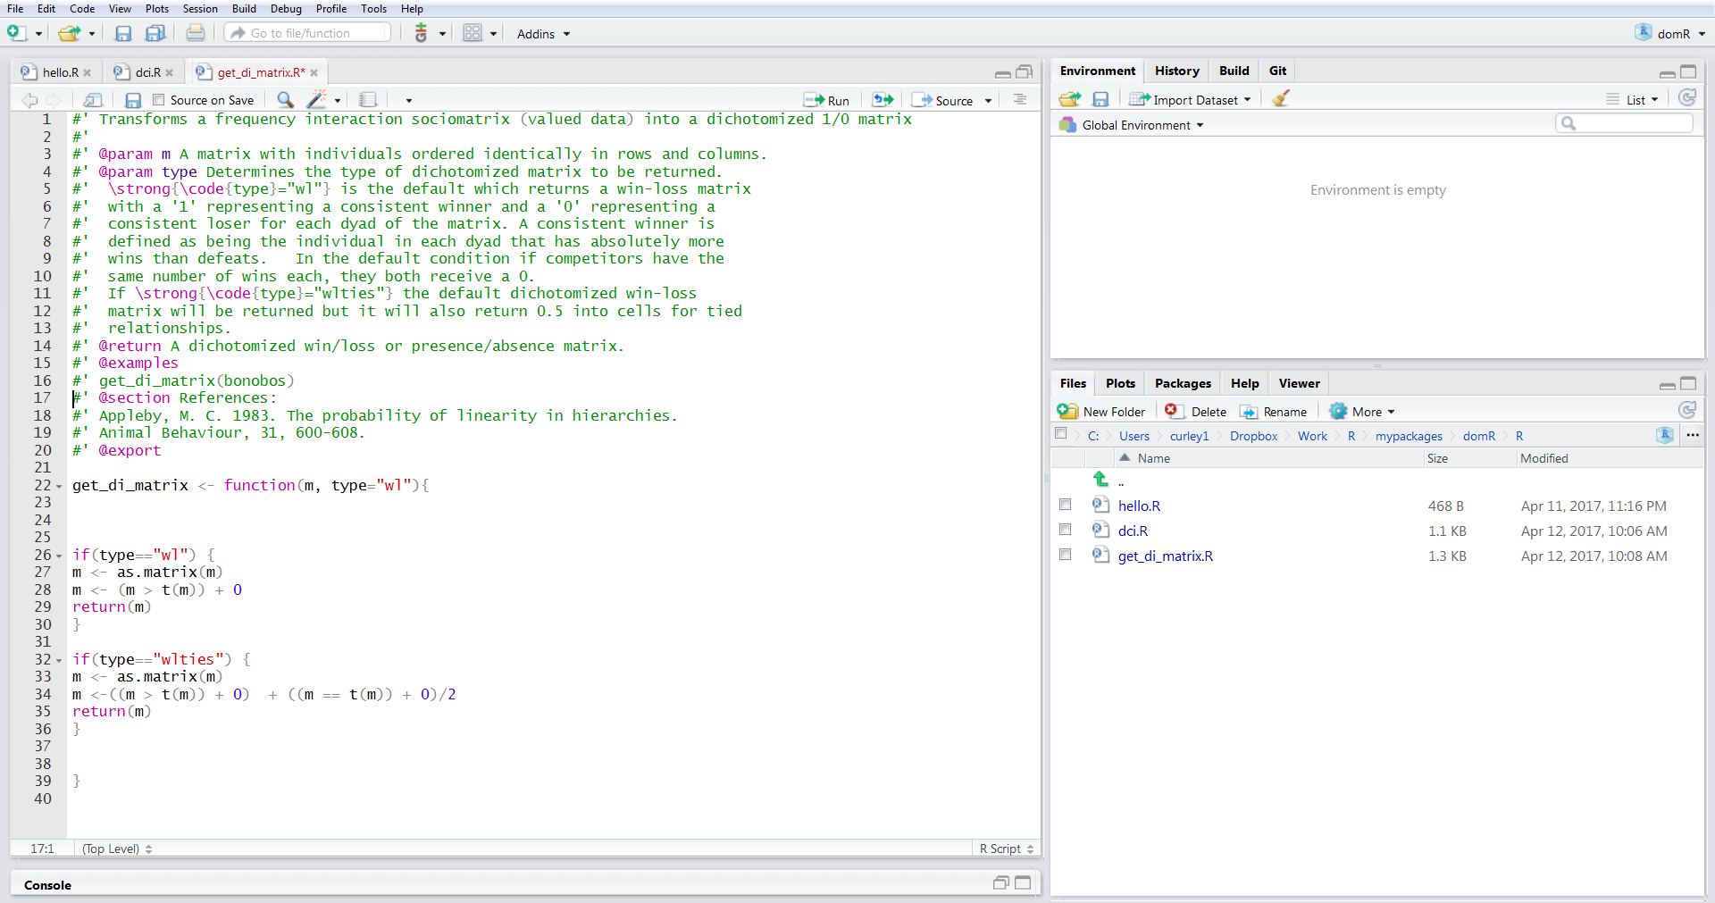
Do for next function …

Slide 20
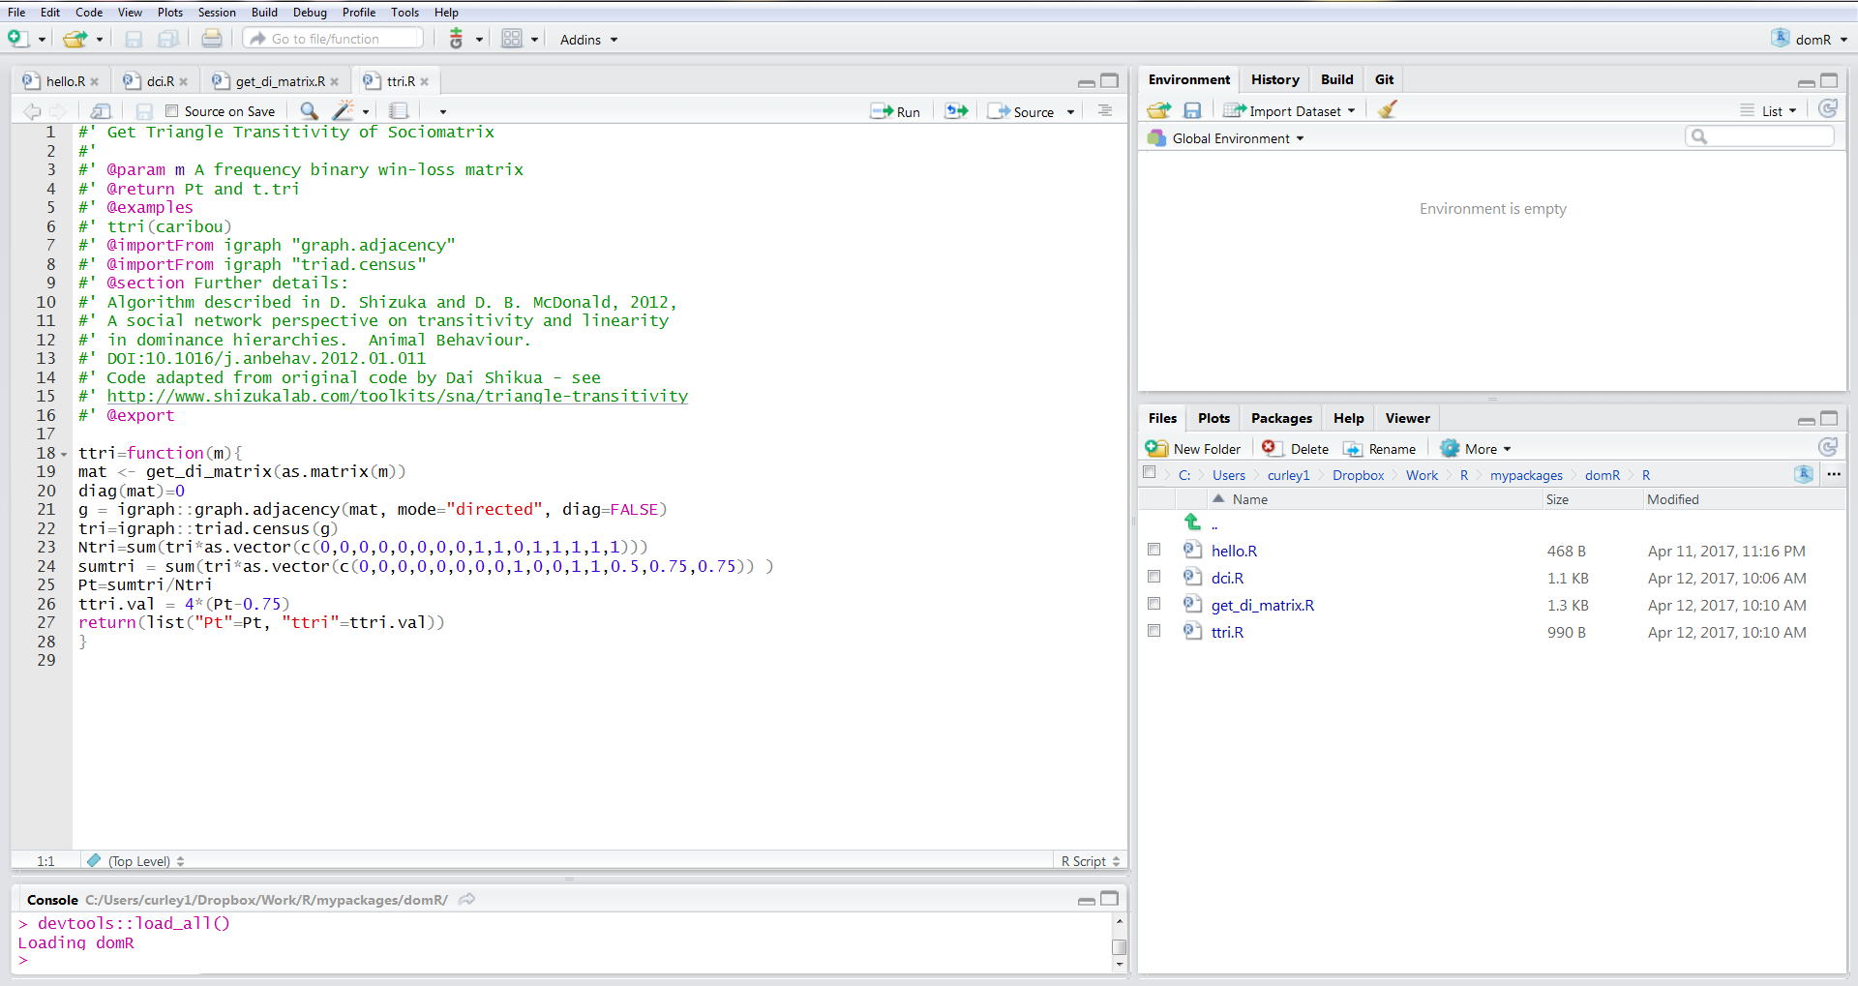
Keep going…
devtools::load_all() [or Ctl/Cmd + Shift + L] will load the package.

Slide 21
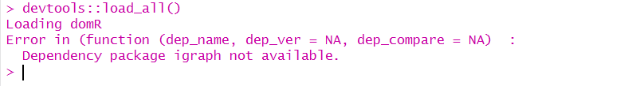
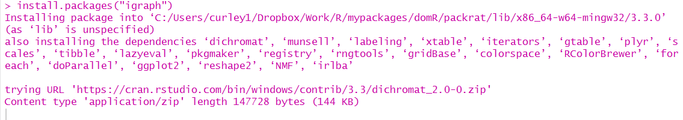
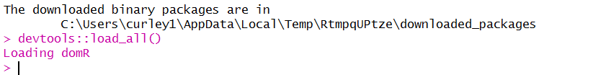
Load .R files …
Fix error !
We’re good

Slide 22
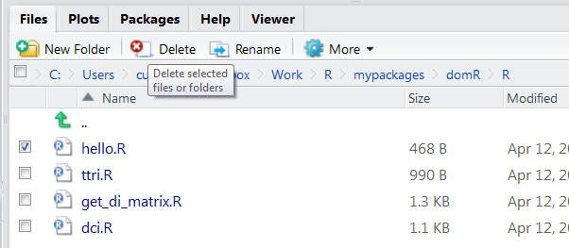
Deleting files
If we don’t want a file – remove it’s .R file and its .Rd file (if it exists).
Easiest way is with the Delete icon in Files window

Slide 23
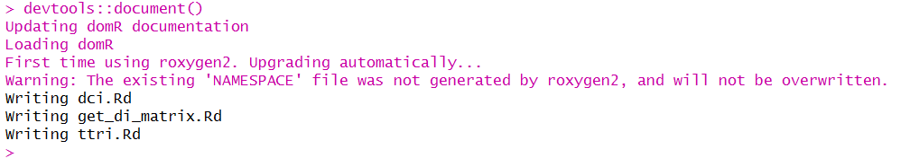
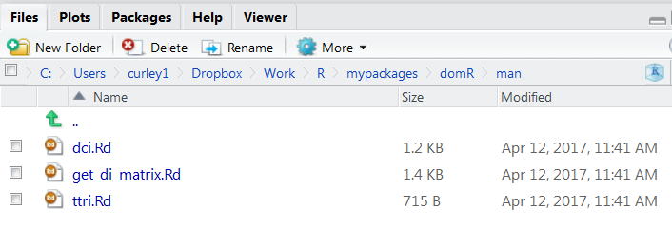
Add documentation Man
devtools::document()
We now have docs !

Slide 24
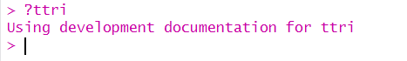
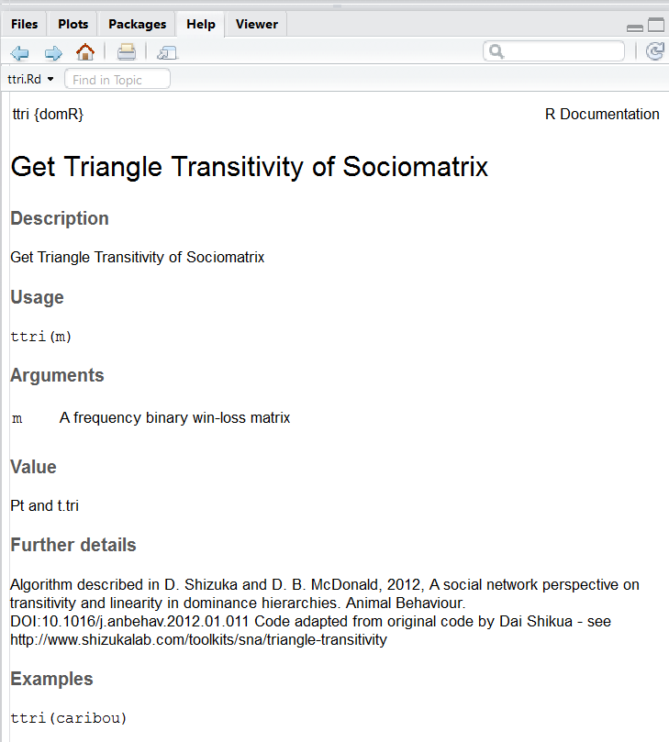
Check them out with “?”

Slide 25

What does this mean ???

Slide 26
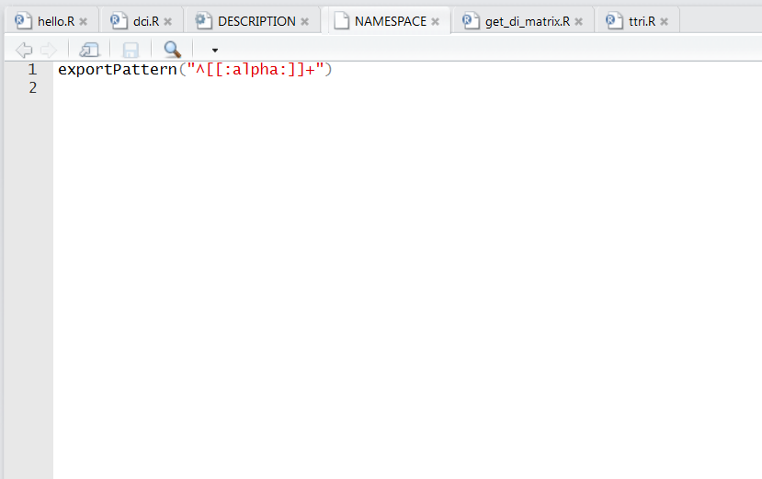
NAMESPACE
This is what the NAMESPACE looked like on initial package set up:

Slide 27
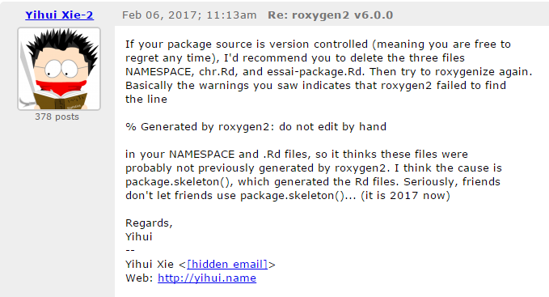
NAMESPACE
Google it:

Slide 28
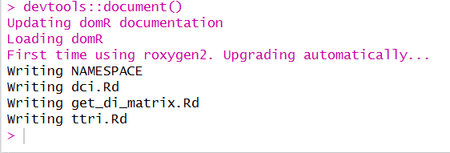

Do as Yihui says …
Delete .Rd files we just made, Delete the NAMESPACE, problem fixed !!!

Slide 29
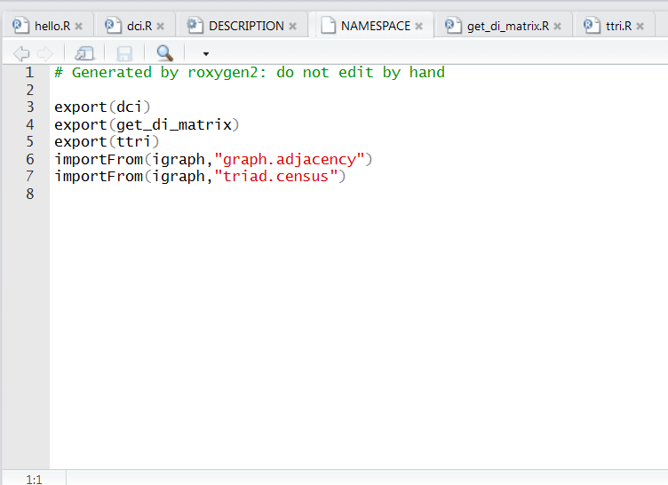
That’s better – it should have the “do not edit by hand”

Slide 30
For every new .R file you will need to run:
devtools::document()
To generate your documentation.
You will also need to run it if you change the information in any .R file
- This often happens after you run CHECKS and realize you made some errors in the text.

Slide 31


Slide 32
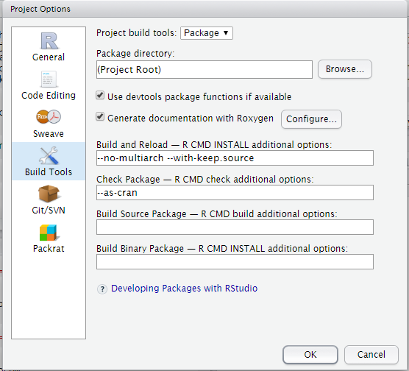
Now check the “Generate documentation with Roxygen” option and put “–as-cran” under Check Package space to simulate the CRAN package checking and testing.
Build > Configure Build Tools.

Slide 33
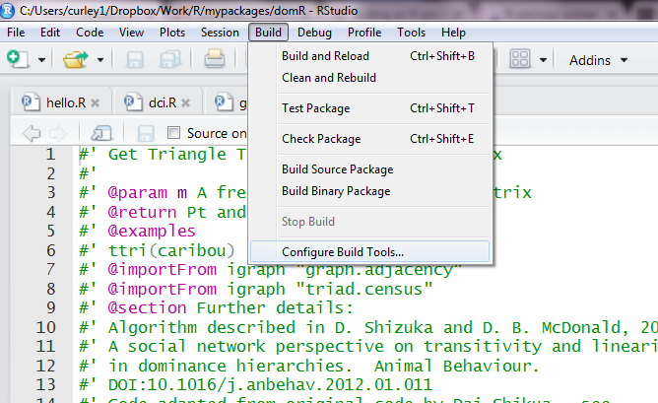
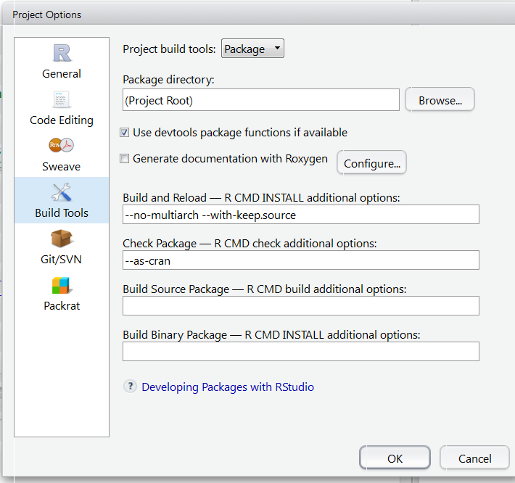
Configure Build Tools … (this is for CRAN checks so not entirely necessary for all)
Add: --as-cran

Slide 34
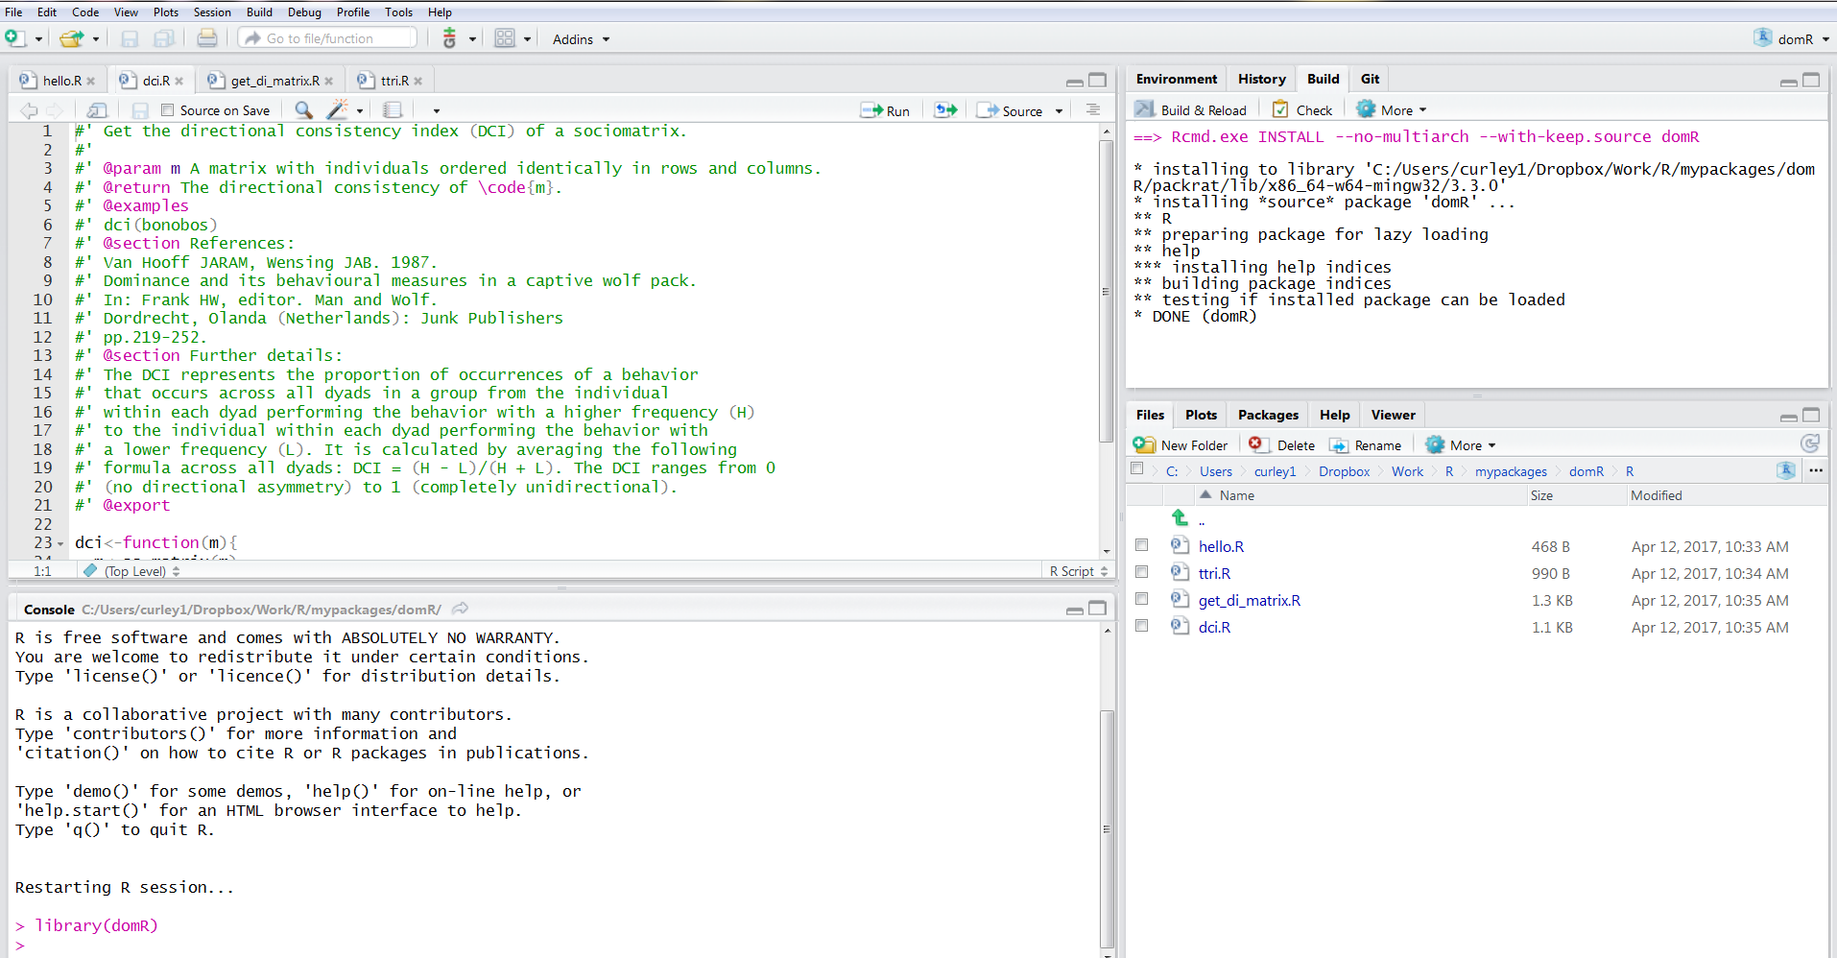
Build & Reload

Slide 35
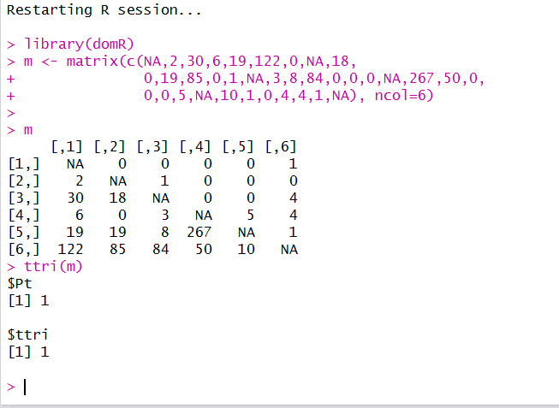
You should be able to start using your functions now like a regular package:

Slide 36


Slide 37

Often you will want to add data to the package:
for examples
for users
for functions

Slide 38
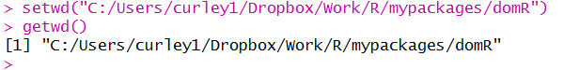
It’s worth checking that the working directory is your project at this point:

Slide 39
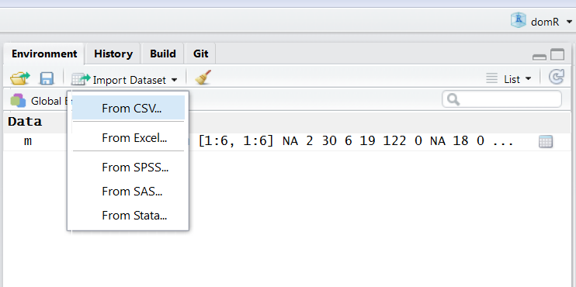
Here’s how to make a data file available to users of your package
Example: Load “caribou.csv” into Global Environment

Slide 40
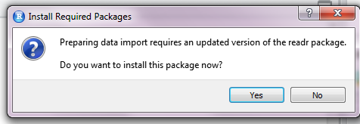
If you’re following this tutorial and using “packrat”, and you import using the Rstudio dropdown menu you will get this prompt: Hit “YES”
You could also import your data file in any other way to your working directory
that you are comfortable with.

Slide 41
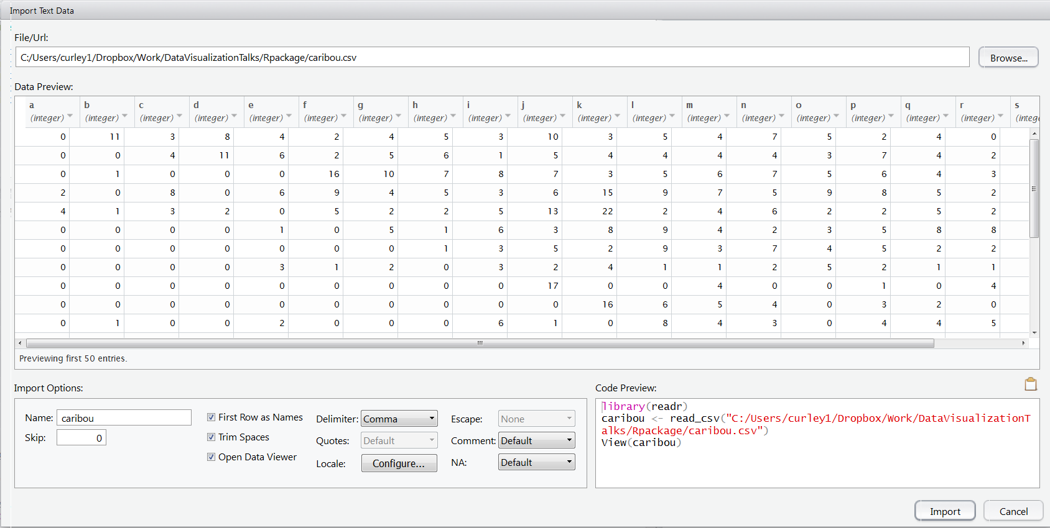
Importing …

Slide 42
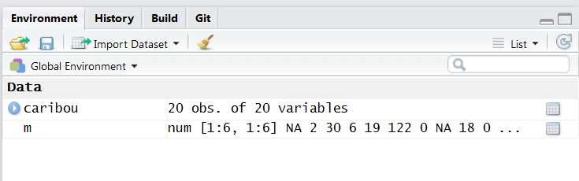
It should be in your Global Environment …
The “m” is the object we used to test our function earlier
The data object should have the name that you want it to be called in your package.

Slide 43
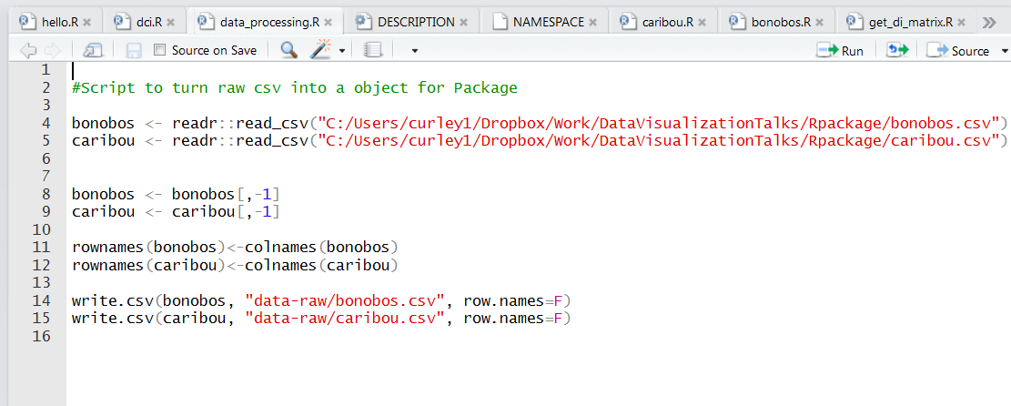

Slide 44
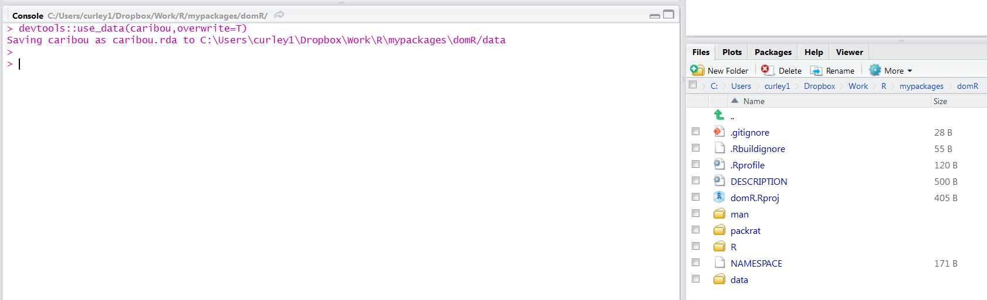
Creating our first data object
devtools::use_data()
Will create a “DATA” folder
Will save the object as a “.rda” file in the DATA folder
Use “overwrite=T” to replace an existing file of same name (or just add file if no file of that name)
devtools::use_data(caribou,overwrite=T)

Slide 45
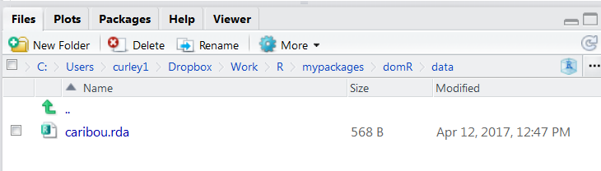
The file should now be in the “DATA” folder:

Slide 46
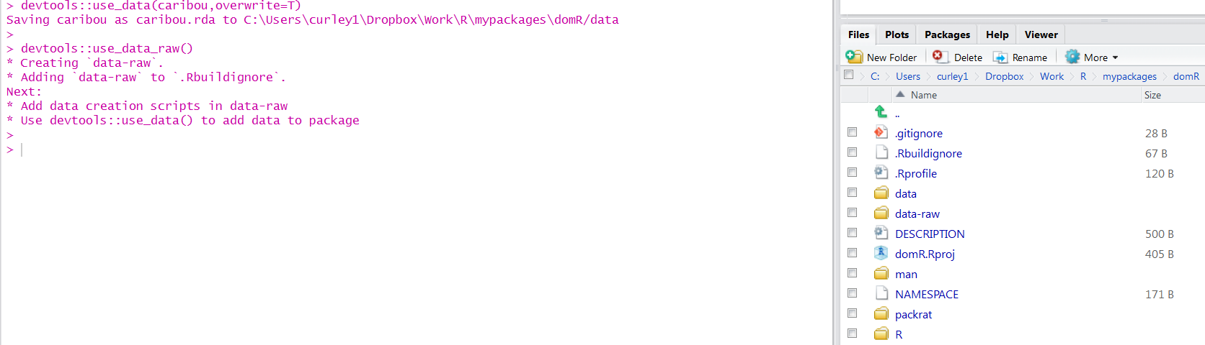
What about raw data ?
- best to keep this and any .R files used in processing data
- to enable anybody to go from raw data to final outcome, should be able to
determine how data was processed
devtools::use_data-raw()

Slide 47
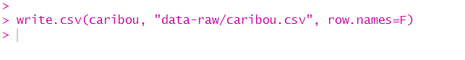
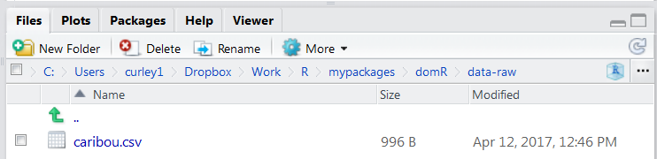
Files that you want to save into “data-raw” can be saved in any format:

Slide 48
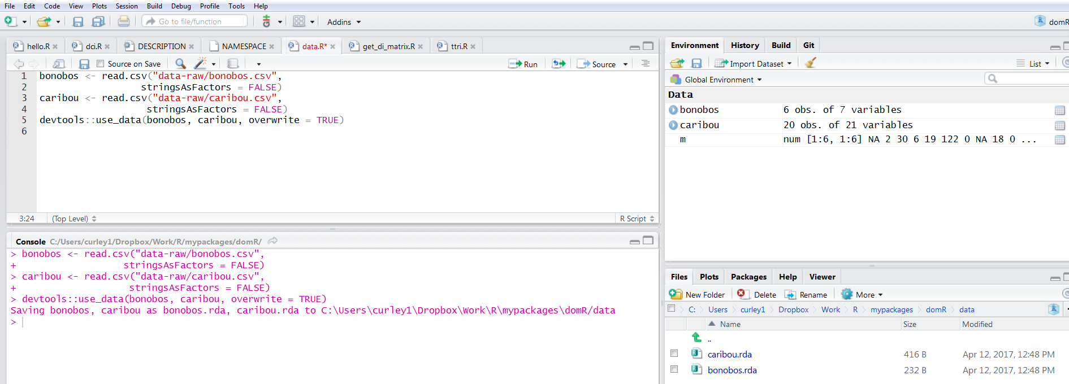
Can do for multiple datasets
Here, using a file called “data.R” that I will save in “data-raw” that contains the code to
load files and save as “.rda” files in “data” folder.
I also added “data_processing.R” into “data-raw” folder

Slide 49
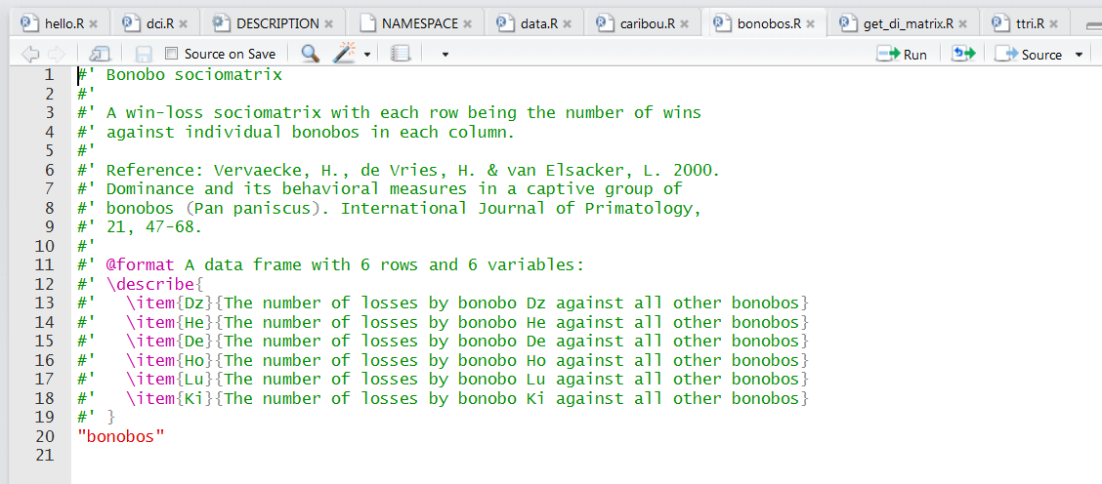
Add .R files to R folder for datasets
Remember:
devtools::document()

Slide 50
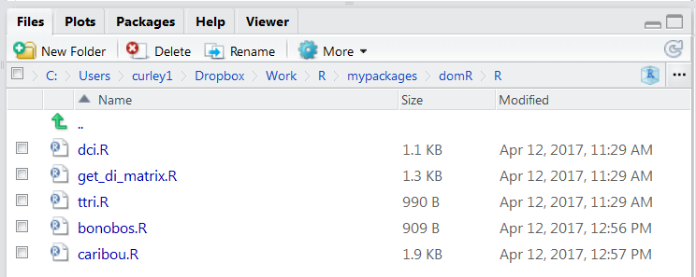
Add .R files to R folder for datasets
These .R files are needed when you run Checks.

Slide 51
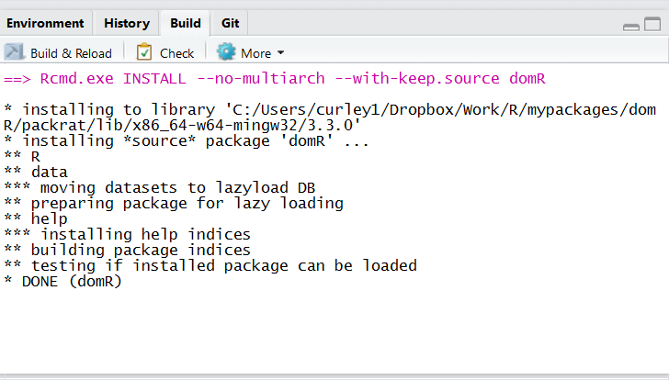
It’s always ok to rebuild

Slide 52
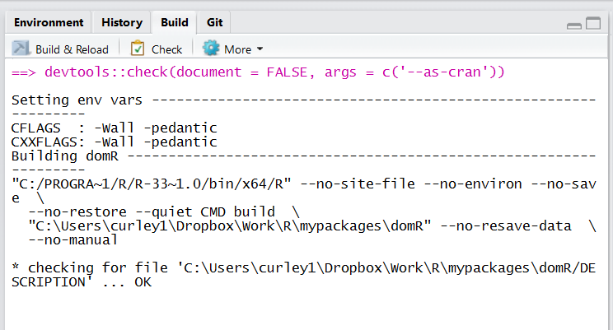
Running a CRAN check
It starts by hitting this button

Slide 53

Running a CRAN check
It then goes like this:

Slide 54
Running a CRAN check
The results will have at the bottom:
ERRORS - you have to fix these immediately !
WARNINGS - you really should fix these immediately !
NOTES - you could not bother – but you should.
The point of this check is to ensure that your package will work consistently.
It can be hard to work out what the ERRORS/WARNINGS/NOTES are referring to, but it’s usually some error in the code or documentation that you’ve written. Persevere with it – Google it !!!
It can help to run checks after every new thing you add to the package – that way you know what went wrong immediately.

Slide 55
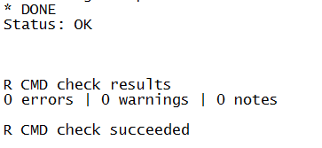


Slide 56



Adding vignettes
devtools::use_vignette()
For other colleagues, for peer-reviewers, for other users, for yourself !!!

Slide 57

You can now edit the vignette….

Slide 58
Install your package into your R system library
devtools::install()
Your package should now be available on your machine whenever you need it.
Access it like you would any other package:
library(“domR”)

Slide 59
Publishing your package - GitHub
Create your repository on GitHub
Add the contents of your entire folder
Install/share from GitHub directly using the following:
devtools::install_github(“jalapic/domR”)

Slide 60
Publishing your package - CRAN
devtools::release()
Follow ALL of the instructions as they appear in the console
Add a file called “cran-comments.md” to the main folder.
This file should contain information based on the CRAN checks (see example).
Add this file to .Rbuildignore
See here: http://r-pkgs.had.co.nz/release.html

Slide 61
Things to cover in version 2 of this tutorial:
Writing tests
Writing a package website using “pkgdown”
Further ‘how-to’ on CRAN submission
Adding other data types e.g. internal only data into a package.

